Slide 1



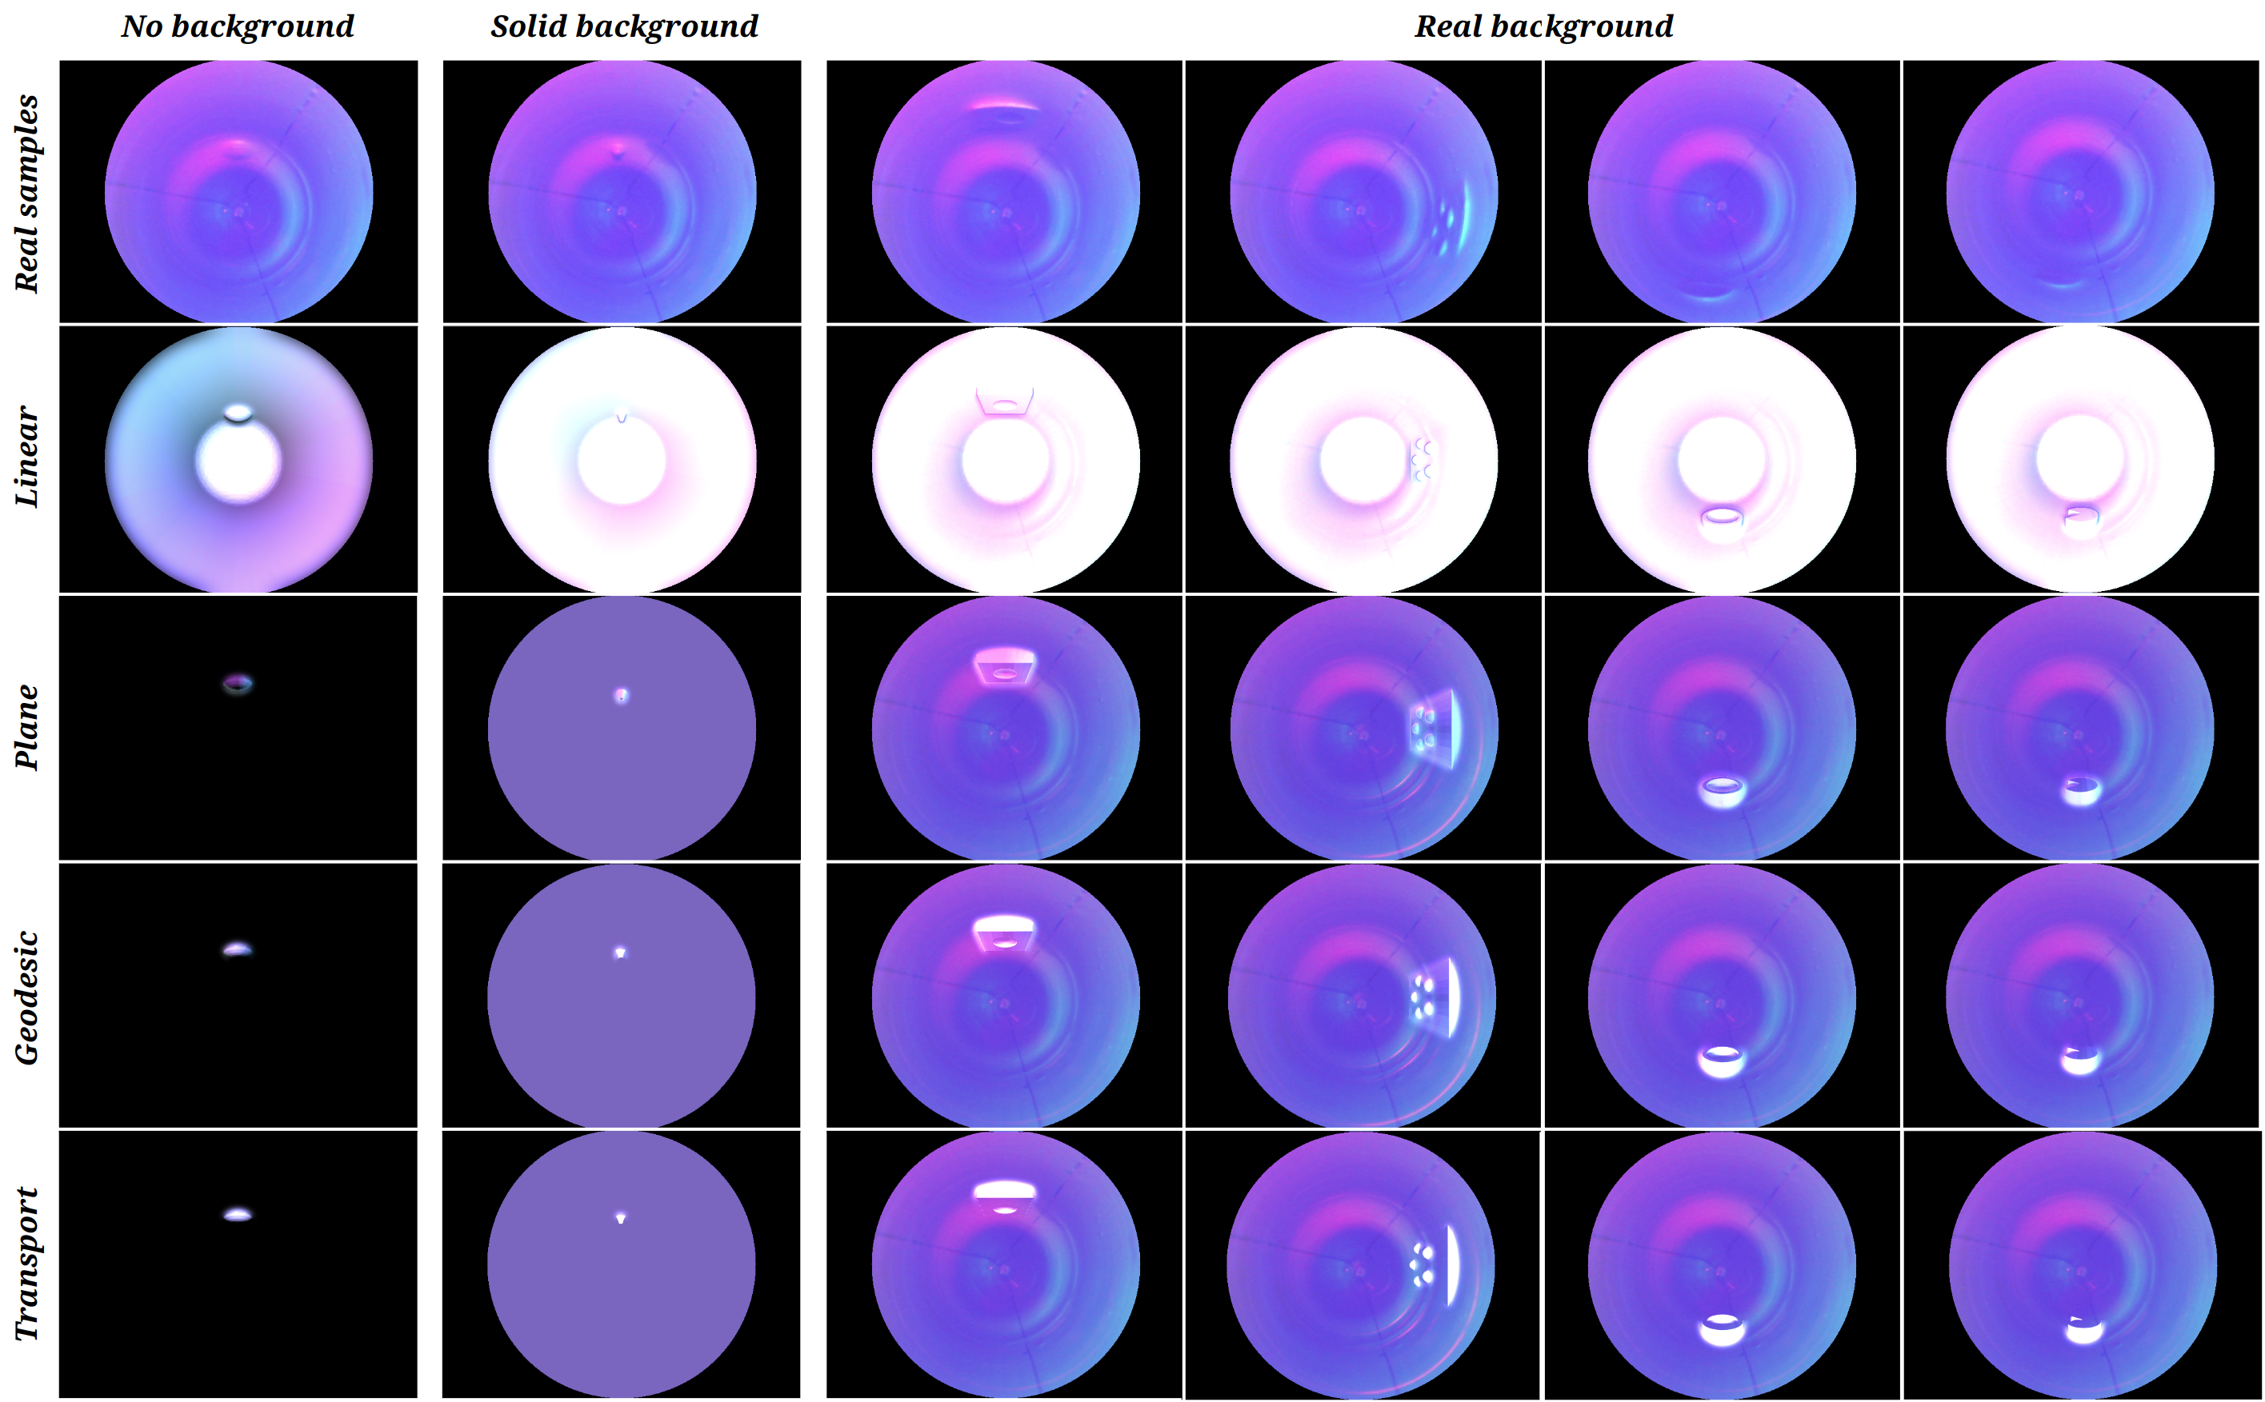
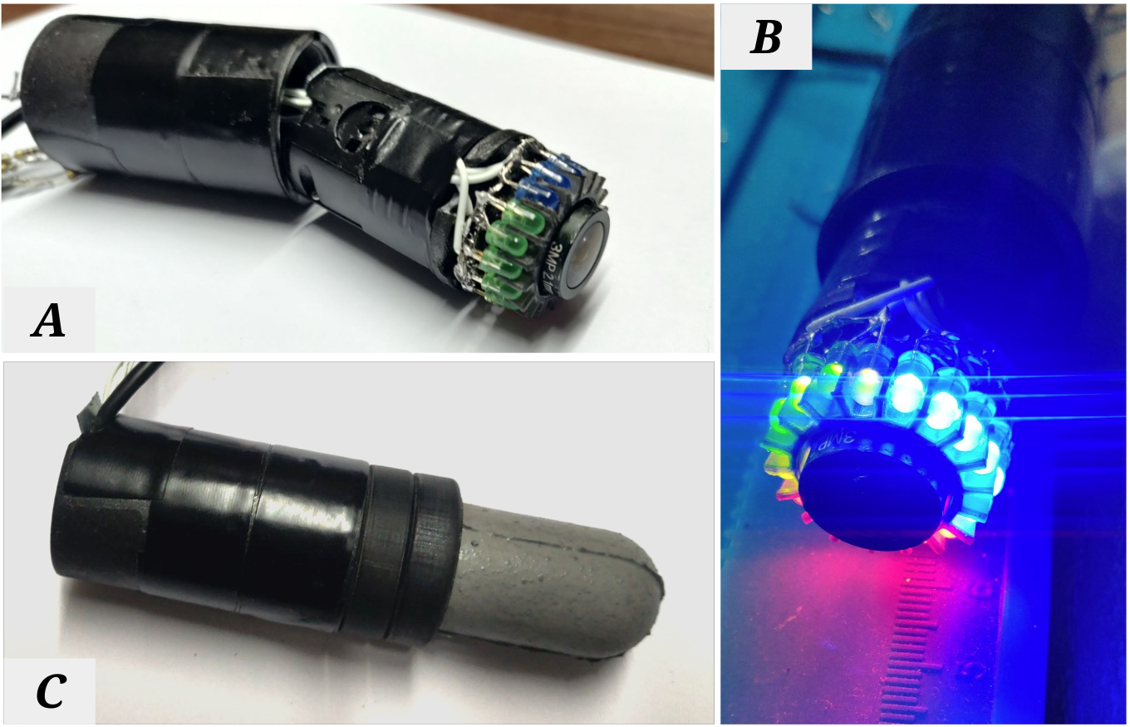
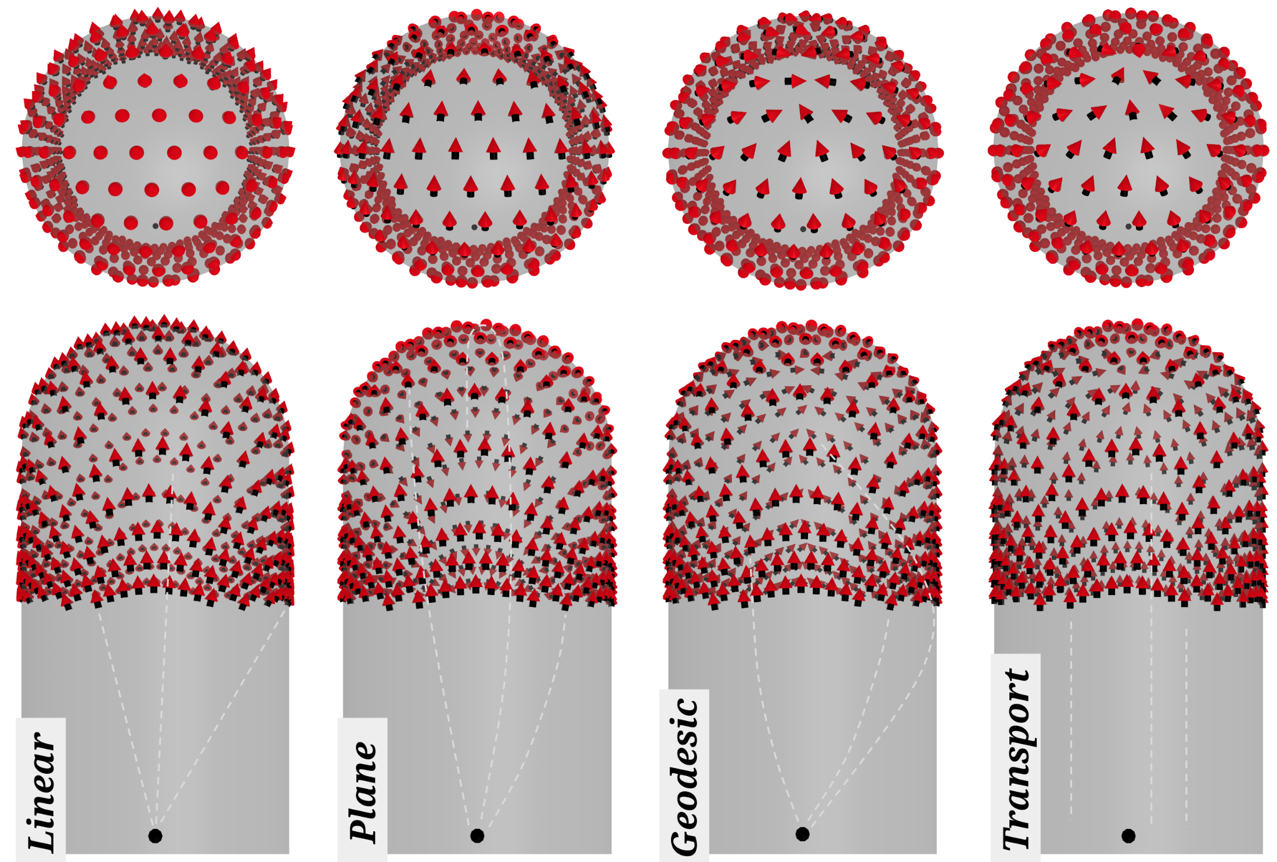
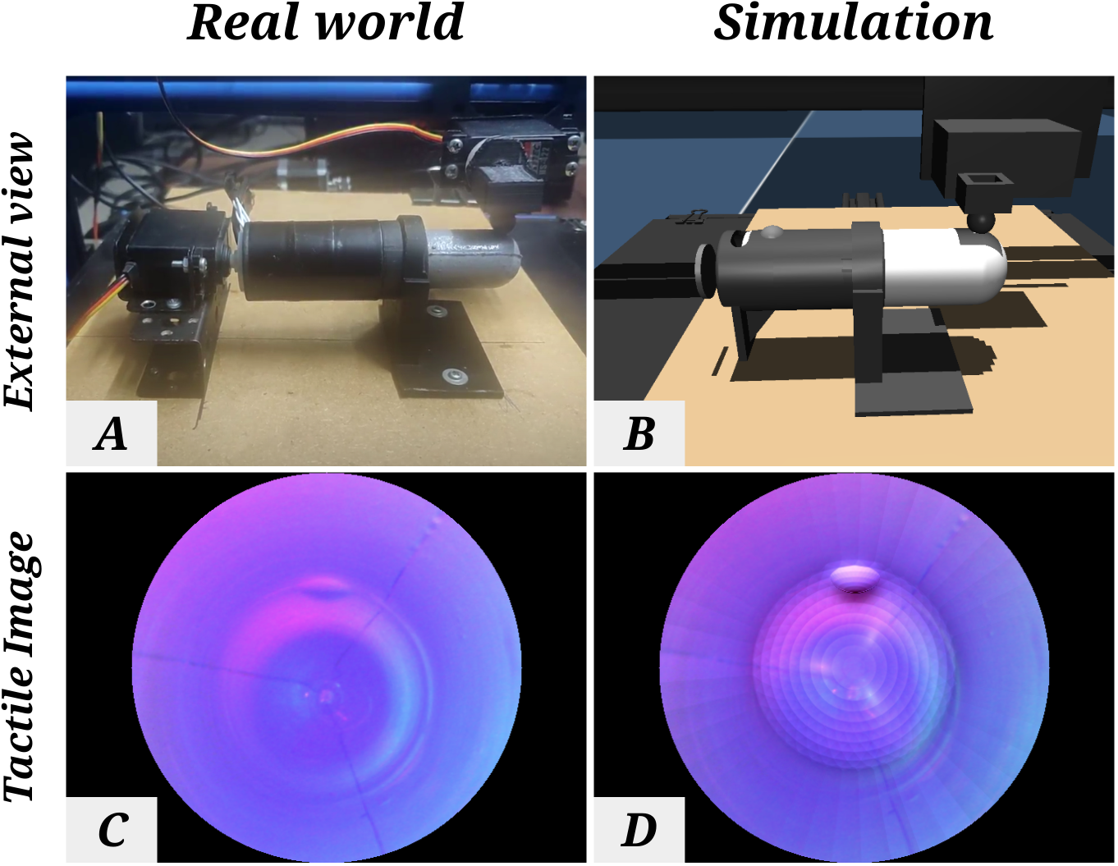
Simulation of Curved GelSight Sensors for Sim2Real Learning
Daniel Fernandes Gomes, Paolo Paoletti and Shan Luo {shan.luo}@kcl.ac.uk, paoletti@liverpool.ac.uk
[ 1 ] D F Gomes, P Paoletti and S Luo, “Beyond Flat GelSight Sensors: Simulation of Optical Tactile Sensors of Complex Morphologies for Sim2Real learning”, RSS 2023
[2] D F Gomes, P Paoletti and S Luo, “Generation of GelSight Tactile Images for Sim2Real Learning”, IEEE RA-Letters, April 2021 [3] D F Gomes, Z Lin and S Luo “GelTip: A finger-shaped optical tactile sensor for robotic manipulation”, IROS 2020

